Slide 1

Data Quality

Slide 2
Employee master data is a link in the chain
Pension record for Local Plus
Outside Org Structure
Shadow pension not recorded at host (other international location)
People Search
Displays location based on Host record
myTravel
Displays content based on Host record location
Global
Regular
myTools
Performance
Talent
Remuneration
Host record
Physical location
Triggers workflow
My Expenses
Displays currency based on Host record

Slide 3

When the link break
Pension record for Local Plus
Outside Org Structure
Shadow pension not recorded at host (other international location)
People Search
Displays location based on Home record
myRioTinto
Displays content based on Home record location
Global
Global
My Expenses
Displays currency based on Home record location
myTools
Performance
Talent
Remuneration
Host record
- Physical location
Impact to Employees in multiple systems (110)

Slide 4




Annual cost of poor HR data quality
Direct Costs due to low data quality USD$ 2.1 million
Costs of improving or assuring data quality USD$ 1.1 million
Verification
Data re-entry
Escalation
Prevention
Detection
Data re-entry
USD$ 0.2 million
Detection
USD$ 0.9 million
Indirect Costs based on lower HR reputation, productivity loss or incorrect data used to make wrong decision or actions

Slide 5












Impact of poor HR data quality
Orphan Positions
Workflow unavailable
Record not flowing to myTools
Duplicate Employees
Tenure
Payroll risk
Remuneration Data
Incorrect payment
No bonus
Age
Government reporting
Access to benefits
Career Framework
Recruitment delays
Career path
Talent & Succession plan
Emergency Address
Next of kin contact

Slide 6
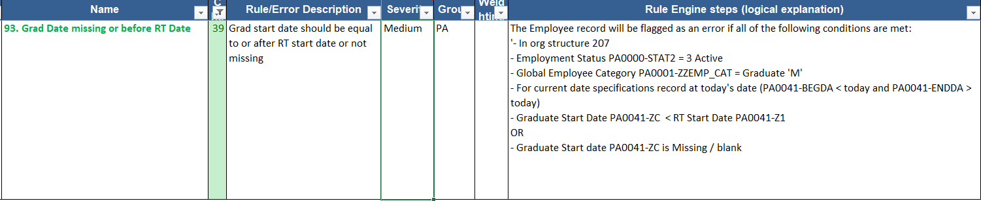
The solution: Data profiling
Data profiling is a technique used to examine data for different purposes like determining accuracy and completeness. This process examines a data source such as a database to uncover the erroneous areas in data.
Profiling techniques require “rules” to examine data for accuracy and completeness.

Slide 7
Data profiling and results “errors”
Data queries run every weekend
Errors are stored in a “new errors” table
All errors are compared to the previous audit run
The status of errors can change from “open” to “close” after every run
37 queries created January 2016
Currently at 96 queries
There is an expectation that data should be cleansed and root cause analysis completed
Continuous improvement budgets are allocated annually (September) and require a strong business case
Performance objectives need to be completed and bonuses are paid on the results of DQ progress
~14mil > records within the current dataset that is difficult to analyse in excel
Quarterly dashboards take 1-2 weeks to complete
Managing process improvements and understanding the impact is critical

Slide 8
Solution
Python - to consolidate 130 csv files containing all audit results
Mongo DB - to store various calculations
Flask – To build web app
Java script libraries
D3 for heat map
High charts

Slide 9
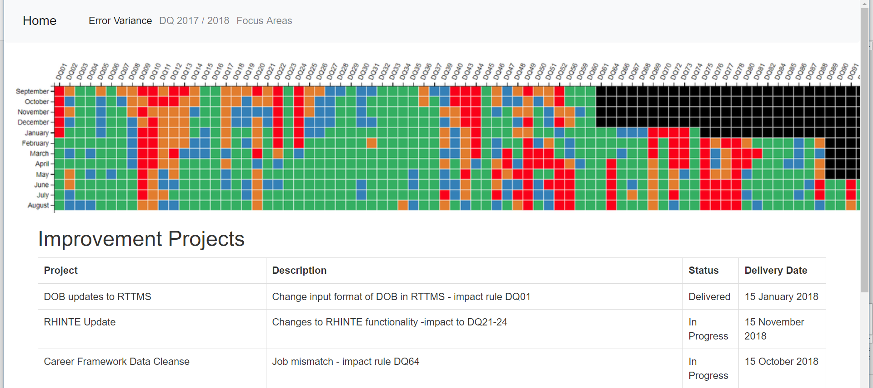
Graph 1 - Heatmap
D3 used to represent past 12 month error data (snapshot)

Slide 10
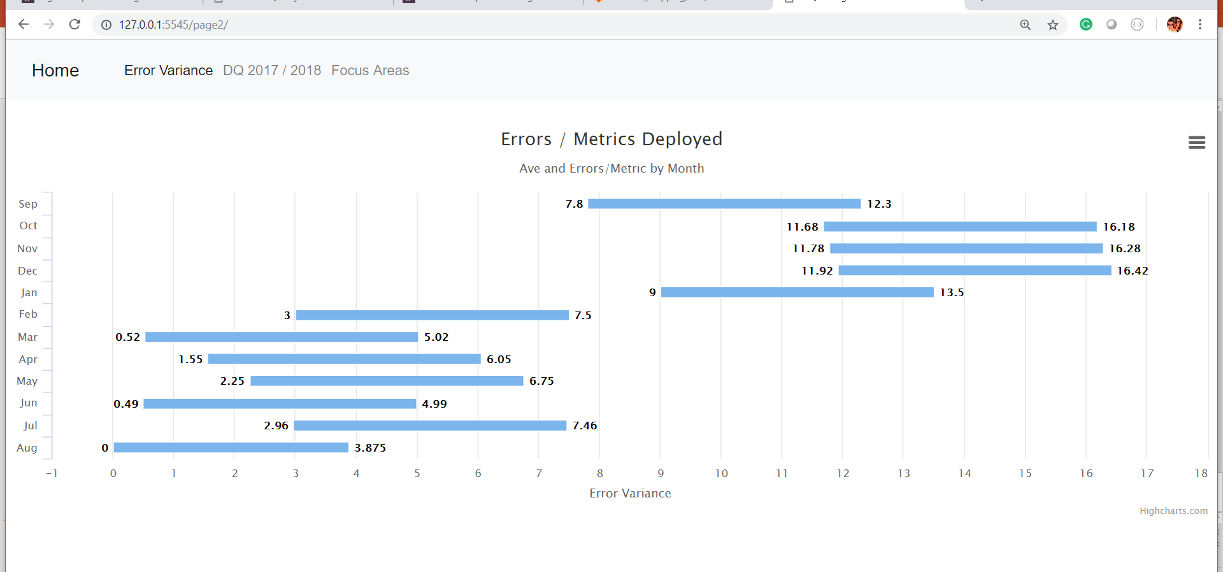
Graph 2 – Error Variance
Highchart Library – looking at the variance between total errors for each audit run per month (4-5 audit runs per month)
The data is errors / total metrics deployed

Slide 11
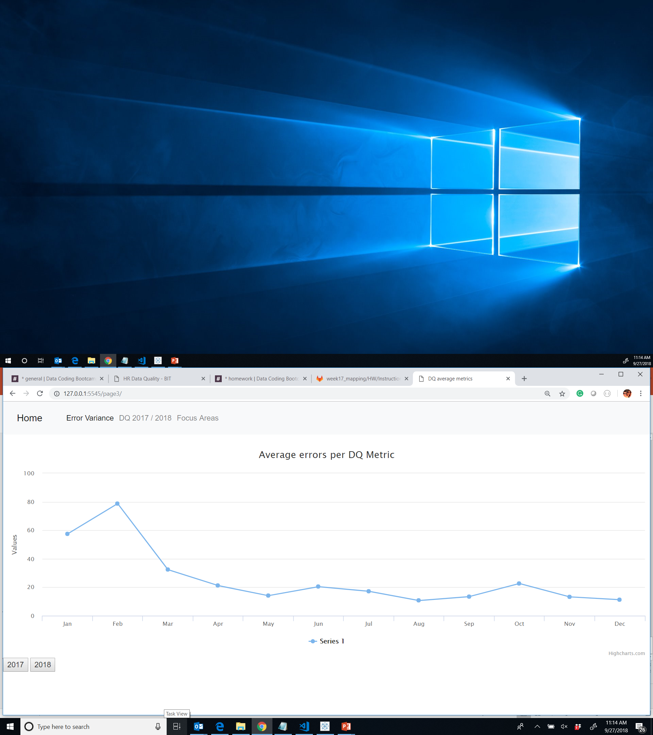

Graph 3 – Errors by year
Highchart Library – Average errors by DQ Metric

Slide 12
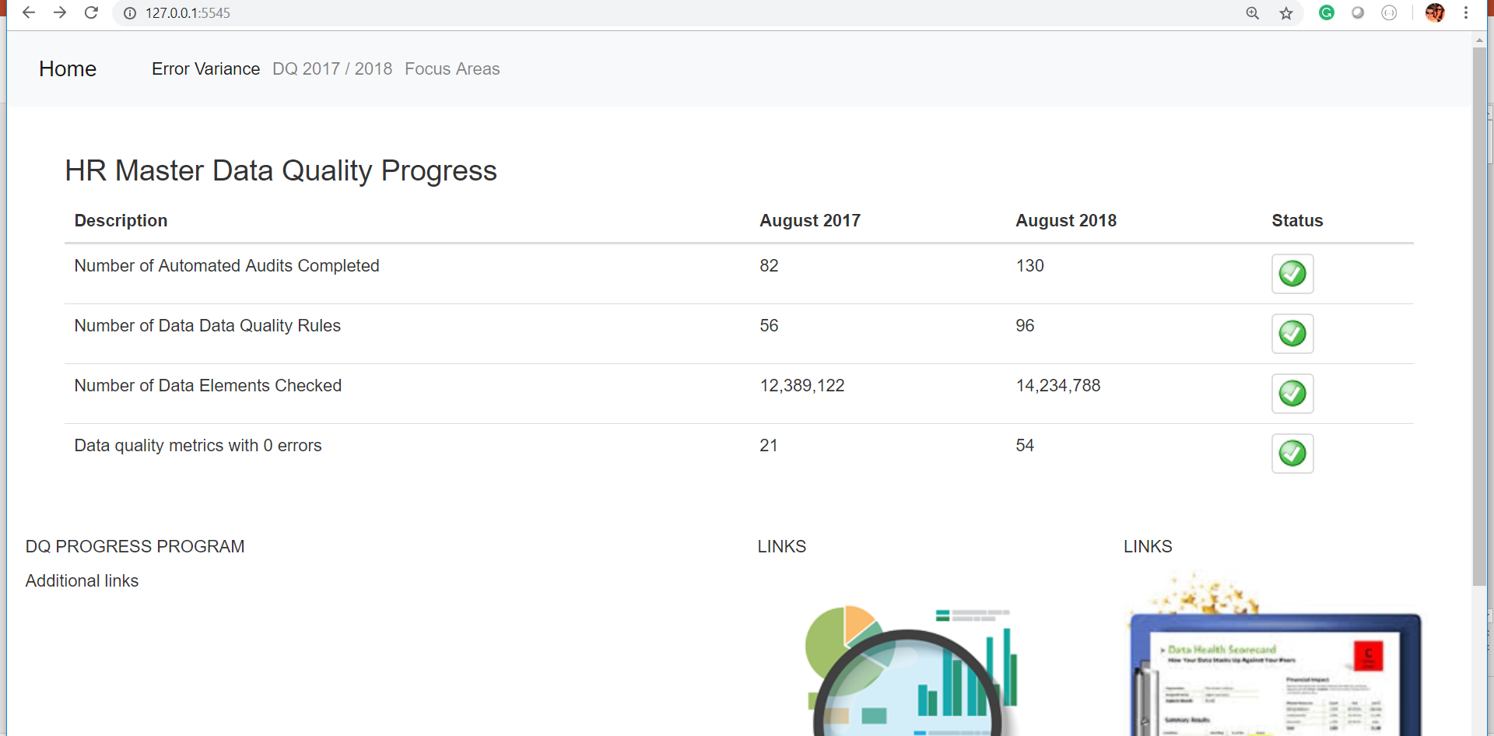
Summary Page

